Slide 1


SEED: SOUND EVENT EARLY DETECTION VIA EVIDENTIAL UNCERTAINTY
Xujiang Zhao¹, Xuchao Zhang², Wei Cheng², Wenchao Yu², Yuncong Chen² , Haifeng Chen² , Feng Chen¹
¹The University of Texas at Dallas, ²NEC Laboratories America
IEEE ICASSP 2022
Notes:
Hello, my name is Xujiang Zhao from UT dallas, I am going to present our paper: SEED: SOUND EVENT EARLY DETECTION VIA EVIDENTIAL UNCERTAINTY.
This is a joint work with Dr. Feng Chen, Xuchao Zhang², Wei Cheng², Wenchao Yu², Yuncong Chen² , Haifeng Chen² from NEC lab America

Slide 2
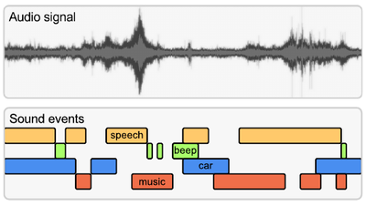
Motivation
Sound is everywhere. Sound event would happen in many environments: domestic environment, plant environment, etc.
Real-time response after the event is happened.
Audio stream (Collected by real-time sensors)
Sound Event Early Detection (SEED)
Input: stream audio
Detect each event and reduce the detection delay
Early detection
Delay
Sound Event Early Detection would focus on early detection
Notes:
Sound is everywhere in our world. Sound event would happen in many environments: domestic environment, industrial plant environment, etc. Sound event detection is trying to classify the event and also provide the location of the event. While in some situation, especially in the industrial case, it is important to real-time response the event when it happened.
That is our project would focus on: Sound Event Early Detection. Given a steam audio, our goal is to Detect each event and reduce the detection delay.

Slide 3
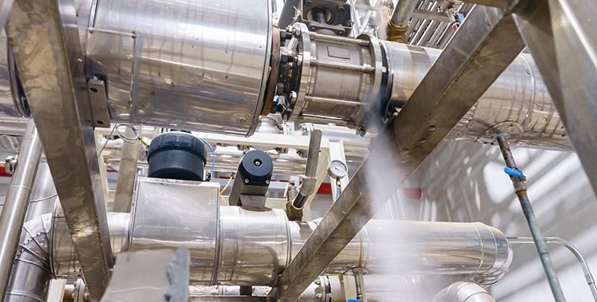
Motivation (Example)
Audio Surveillance: Steam Leak Detection in Thermal Power Plant
Purpose: Detecting the sound waves emanating from the steam leak.
Benefits
Increase operating profits
Ensure personal safety
Avoidance of unscheduled outages
Sai et al. Application of Acoustic Techniques in Thermal Power Plants
Impact of Sound Event Early Detection

Slide 4
Challenge
I. Overlapping sound event
It is difficult to detect target event due to overlapping of polyphony sound.
Background Nosie
Steam Leak
Background Nosie
II. Difficult to detect sound event in early stage
Early stage: 1-2 small detection windows (60ms).
III. Real-time inference
Inference time < detection window.
Challenge of Sound event early detection

Slide 5
Contribution
We proposed a Multi-label Evidential neural network to solve SEED and provide a realizable prediction based on uncertainty scores.
Our model can significantly reduce the detection delay and improve the prediction accuracy.
The evidence information (include belief, disbelief and uncertainty) can help human being to make better decision.
Contribution

Slide 6
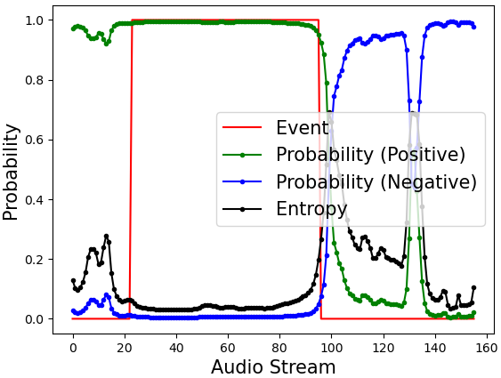



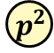

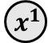
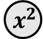
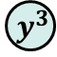
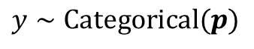
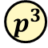
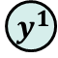
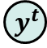
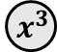
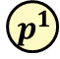


Limitation of existing method
$${ y}^{1}$$
$${ y}^{2}$$
$${ y}^{3}$$
$$y∼Categorical(p)$$
$${ y}^{t}$$
The prediction is not reliable at the early stage
Baseline Model
$${ p}^{1}$$
$${ p}^{2}$$
$${ p}^{3}$$
… …
$${ p}^{t}$$
Prediction with
overconfidence
Bi-GRU
Bi-GRU
Bi-GRU
… …
Bi-GRU
CNN
CNN
CNN
CNN
… …
$${ x}^{1}$$
$${ x}^{2}$$
$${ x}^{3}$$
$${ x}^{t}$$
We consider Evidential Uncertainty to improve the performance of early sound event detection!
Fourier transform
… …
Streaming Data (audio signal)
Notes:
Here, we introduce a baseline for sound event early detection. Given the streaming audio signal, after the Fourier transform, we get the x_1, x_2 and until the current segment x_t, the baseline consider a CNN+RNN model to predict the class probability for each x_t.
The right figure is a binary case example of using baseline model to do early detection, we can see that the baseline model give a positive prediction when event is not happening. We call this is the overconfidence issue.
In our work, we consider Evidence Uncertainty to solve this overconfidence issue!

Slide 7
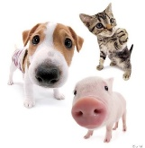
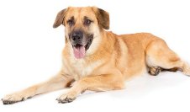

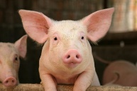
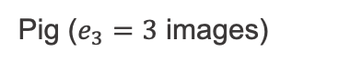
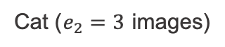
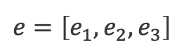
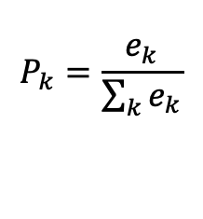
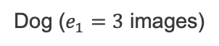
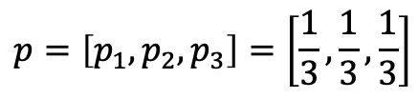
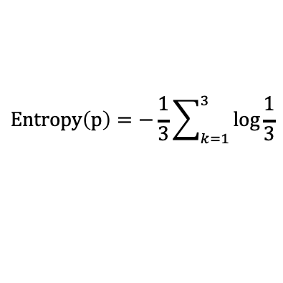
Background of Evidential Uncertainty
We obtain the empirical evidence of the test image from training set (most similar training images):
Test image:
Empirical evidence:
Dog ($e_{1}=3$ images)
Cat ($e_{2}=3$ images)
Pig ($e_{3}=3$ images)
$$e=\left[e_{1},e_{2},e_{3}\right]$$
Evidence: a measure of the amount of support for a certain class
In deep learning, the researchers are interested in predicting class probabilities
(Class probabilities)
$$P_{k}=\frac{e_{k}}{\sum_{k}{e_{k}}}$$
$$p=\left[p_{1},p_{2},p_{3}\right]=\left[\frac{1}{3},\frac{1}{3},\frac{1}{3}\right]$$
(Probabilistic uncertainty)
$$Entropy\left(p\right)=−\frac{1}{3}\sum_{k=1}^{3}{\log{\frac{1}{3}}}$$
Notes:
Well, what is the evidence uncertainty? I will use this simple image classification to introduce evidence uncertainty.
In this three classes classification task, our training set includes dog, cat and pig three classes, then for a test image, we will collect the empirical evidence by find the most similar training images. For example, in this case, the test image include all three animals, the empirical evidence is 3 for each class.
Then, we can use the evidence to quantify different uncertainty induced by different root causes. In deep learning, we are often interested in predicting class probabilities. In this example, the vector of probabilities, denoted by p, can be calculated based on a normalization of the evidence of the three classes. Based on the estimated class probabilities, we can then calculate its entropy uncertainty.

Slide 8
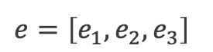
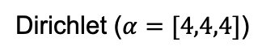
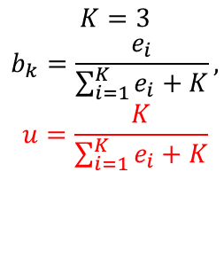
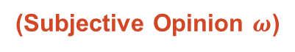
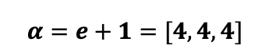
Background of Evidential Uncertainty
We obtain the empirical evidence of the test image from training set (most similar training images):
Test image:
Empirical evidence:
Dog ($e_{1}=3$ images)
Cat ($e_{2}=3$ images)
Pig ($e_{3}=3$ images)
$$e=\left[e_{1},e_{2},e_{3}\right]$$
In the belief theory domain (e.g., subjective logic), the researchers are interested in predicting subjective opinions
(Subjective Opinion $ω$)
$$K=3$$
$$b_{k}=\frac{e_{i}}{\sum_{i=1}^{K}{e_{i}+K}},$$
$$u=\frac{K}{\sum_{i=1}^{K}{e_{i}+K}}$$
$ω=\left[b_{1},b_{2},b_{3},u\right]=\left[0.25,0.25,0.25,0.25\right]$
Vacuity
$$α=e+1=[4,4,4]$$
Dog Class
Cat Class
Pig Class
Dirichlet ($α=[4,4,4]$)
Notes:
In the belief theory domain, such as subjective logic, the researchers are often interested in predicting subjective opinions, rather class probabilities. In this example, the subjective opinion is defined as the beliefs of the three classes, denoted as b1, b2 and b3, plus an uncertainty component, denoted as u. The summation of all the beliefs and the uncertainty should equal to 1. Using the equations on the right, we can calculate the beliefs b1= b2 = b3 = 0.25. The uncertainty u equals to 0.25.
There is a very nice property of subjective opinions. A subjective opinion can be equivalently represented by the parameters of a Dirichlet distribution, denoted as alpha, based on the relation that alpha equals the evidence e plus 1. Here we show the density plot of a Dirichlet distribution in a simplex of the three classes.

Slide 9
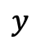
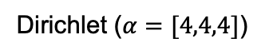
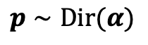
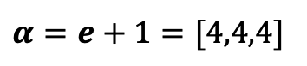
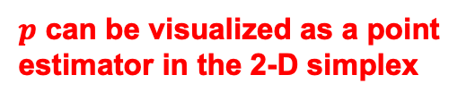
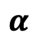
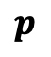
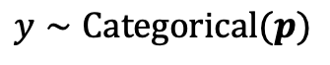
Background of Evidential Uncertainty
We obtain the empirical evidence of the test image from training set (most similar training images):
Test image:
Empirical evidence:
Dog ($e_{1}=3$ images)
Cat ($e_{2}=3$ images)
Pig ($e_{3}=3$ images)
$$e=\left[e_{1},e_{2},e_{3}\right]$$
$$e=\left[e_{1},e_{2},e_{3}\right]$$
In deep learning, we are interested in predicting class probabilities
In the belief theory domain (e.g., subjective logic), we are interested in predicting subjective opinions
(Class Probabilities)
(Subjective Opinion)
$$p=\left[p_{1},p_{2},p_{3}\right]=\left[\frac{1}{3},\frac{1}{3},\frac{1}{3}\right]$$
$ω=\left[b_{1},b_{2},b_{3},u\right]=\left[0.25,0.25,0.25,0.25\right]$
$$α=e+1=[4,4,4]$$
$$y$$
$$y∼Categorical(p)$$
Dog Class
$$p$$
$$p∼Dir(α)$$
$p$ can be visualized as a point estimator in the 2-D simplex
Cat Class
Pig Class
$$α$$
Dirichlet ($α=[4,4,4]$)
Notes:
We can find some connections between class probabilities and subjective opinions.
First, if the uncertainty u in a subjective opinion equals to 0, then the beliefs of the three classes, b1, b2, and b3, are the same as the class probabilities, p1, p2, and p3, respectively.
Second, the vector of class probabilities p in this example can be shown as a point estimator in the simplex of a Dirichlet distribution.
From the Bayesian view, the class probabilities are the parameters of a Categorical distribution about the true class label y of the test image. In comparison, alpha are the parameters of a prior Dirichlet distribution of the class probabilities p. It indicates that class probabilities provide the first-order uncertainty information, but a Dirichlet distribution provides the second-order uncertainty information about the true class label of the test image.
These connections indicate that a Dirichlet distribution is able to quantify more information of uncertainty than class probabilities.

Slide 10
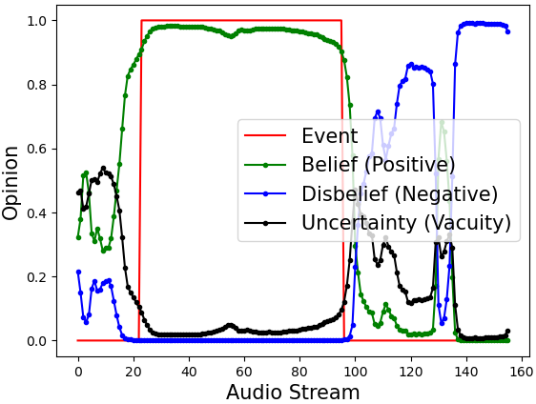
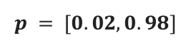
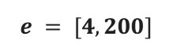
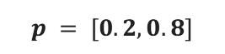
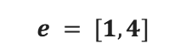
Advantage of Evidence-based model
Baseline
Ours
A binary case with two beliefs
Prediction with
overconfidence
Prediction with low uncertainty
Prediction with High vacuity
Evidence
$$e = [1, 4]$$
Evidence
$$e = [4, 200]$$
Probability
$$p = [0.2, 0.8]$$
Probability
$$p = [0.02, 0.98]$$
Entropy
Low
Entropy
Low
Vacuity
High
Vacuity
Low
The uncertainty (opinion) information is important for early detection
Notes:
What is advantage of evidence-based model in sound event early detection?
As we know, for baseline model based on probability and entropy uncertainty may have overconfidence issue. This is because at the beginning stage, the amount of evidence is small, the prediction based on a small number of evidence is not reliable.
After the event going, more and more evidence, then we can make a confidence prediction with low vacuity uncertainty.

Slide 11
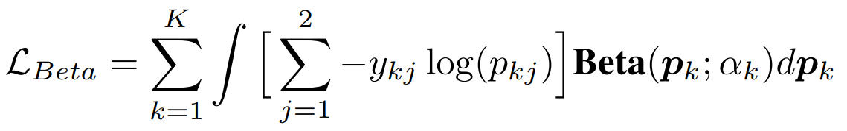
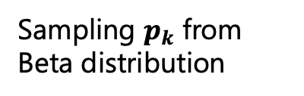
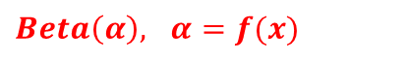
Evidential Sound Event Early Detection
Multi-label Evidential neural network (ML-ENN)
Audio stream
t
$Beta\left(α\right), α=f(x)$
Audio Encoder
Relu
Belief
Disbelief
Uncertainty
Sigmoid
audio segment at time step t
Negative evidence
Positive evidence
Sampling $p_{k}$ from Beta distribution
Cross Entropy
Provide uncertainty information for over lapping sound event (challenge I)

Slide 12
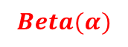
Evidential Sound Event Early Detection
Bi-directional Multi-shift inference
Audio stream
t-m
t
t+n
$$Beta(α)$$
Audio Encoder
Audio segments from [t-m, t+n]
Bi-directional Sequence Model
Relu
(Bi-GRU)
Backward feature
forward feature
Using both forward and backward audio information to estimate evidence more accurately
A balance between delay and accuracy when using forward information
Multi-shift training can overcome the challenge II of small detection window

Slide 13
Results
DESED Dataset: composed of audio clips recorded in domestic environments (Focus on 10 classes such as Speech, Running water and Dishes)
Metrics: Delay & Event F1
 | Delay (seconds) | Event F1
Conformer | 0.372 | 0.639
CRNN | 0.284 | 0.687
Ours (delay) | 0.247 | 0.670
Ours (balanced) | 0.252 | 0.691
Ours (accuracy) | 0.310 | 0.725
Inference time (Challenge III): 5ms << 60ms (detection window)
Our Method can early detect sound events and satisfy the real-time requirement.

Slide 14
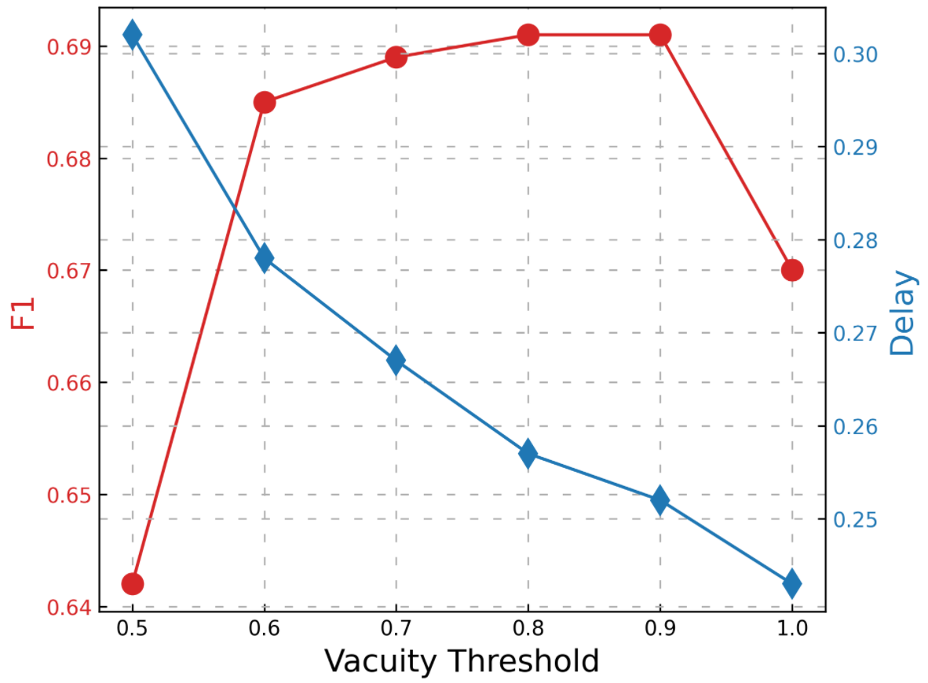
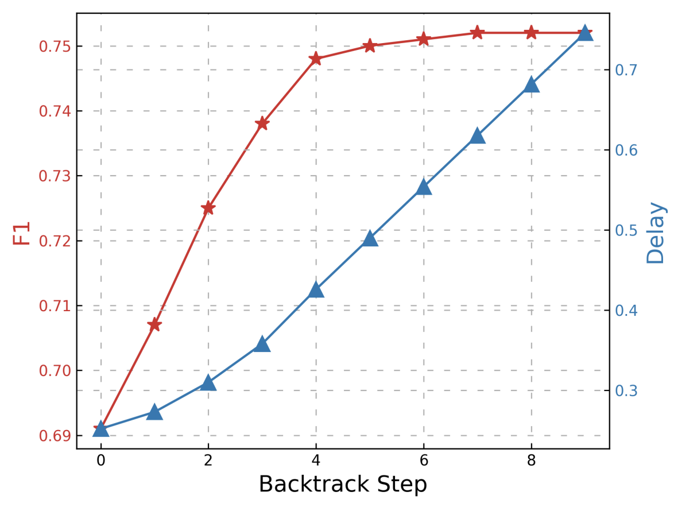
Results
Effect of vacuity threshold
Multi-shift inference
A balance between delay and accuracy when using forward information

Slide 15
Future Work
Consider sequential uncertainty at the inference stage.
Consider multi-label dependency for sound event overlapping.
Apply our model in more real-world datasets.
Sequential Uncertainty and large dataset

Slide 16


